Slide 1
Programming Tutorial Course
michael.berks@manchester.ac.uk
Lesson 4: Writing your own functions: programming constructs

Slide 2
Lesson Overview
Writing your own functions: programming constructs
For loops
While loops
If/else clauses
Switch statements
Control statements: Break, continue, return

Slide 3
Introduction
So far we have seen how Matlab + python interpret and executes lists of commands combining
Basic mathematical operators
Our own functions
Matlab/python’s existing functions
However, to do anything interesting, we need more options than simply running a sequential list of commands
Applying one or more commands repeatedly
Choosing to execute some commands and not others
Programming constructs give us this flexibility
Common to nearly all programming languages
We’ll look at Matlab/python’s take on these…

Slide 4
For loops

Slide 5
For loops
Write a script to display “I will not cut corners” 100 times
We could type the command:
display(“I will not cut corners”); x 100
– not much fun!
We could use cut and paste to help things along…
Or, as we’re too lazy efficient to do that…
for itr = 1:100
display (“I will not cut corners”);
end
In python, try…
for itr in range(100):
print(“I will not cut corners”)

Slide 6
For loops (cont)
What if we want to do nearly, but not quite, the same thing on every line…
Try
for itr = 1:100
display ( [“This is line “ num2str(itr)] );
end
for itr in range(100):
print(“This is line ”, itr)
What do you notice?

Slide 7
Exercises – for loops
Download the scripts loops_example.m and if_else_example.m(.py), run the code
Download the function, roll_a_dice.m(dice_rolling.py), this simulates rolling a dice to return an integer between 1 and 6
Write a function to show the result of rolling a dice 5 times. When your functions runs it should produce a result like:
Roll 1, you scored 3
Roll 2, you scored 1 etc…
Change the function so it has an input that specifies the number of rolls
Hint: use the examples in the scripts to help you. Bart may also provide some assistance!

Slide 8
For loops – general template
for iter_var = A
%Lines of code that do stuff
…
…
end
We call this a “control block”
Is equivalent to repeating the code in pink (the “control block”), once for each column in A
At the start of each repetition, iter_var takes the value of the next column in A

Slide 9
iter_var = A(:, 1);
%Lines of code that do stuff
…
iter_var = A(:, 2);
%Lines of code that do stuff
…
iter_var = A(:, end);
%Lines of code that do stuff
…

Slide 10
For loops - notes
A can be any array
Most common to use simple row vector of increasing integers (like our first examples)
But could use string (i.e. char array) or cell array
The code in the pink box can be any valid Matlab commands
Including another loop or any of the control statement we cover today
It can also modify iter_var or A…
… but DON’T DO THIS!!!
See examples in loops_example.m

Slide 11
For loops – general template
So is this :
for iter_var in iterator:
%Lines of code that do stuff
This indentation is important – python control blocks are determined by their indentation!
Repeat the control block in pink, once for each value in the iterator
Iterator can be different types of object
Most common usage range, a list or tuple
See here for a tutorial on general iterator objects
https://www.geeksforgeeks.org/iterators-in-python/
Also see enumerate:
https://www.geeksforgeeks.org/enumerate-in-python/
My favourite python trick!

Slide 12
While loops
For loops mean we need to pre-program how many iterations we have
Sometime we want more flexibility than that
Imagine we want to simulate rolling a dice until we score a six
The number of times we repeat the action (rolling a dice), depends on the outcome of that action (the score of the dice)
While loops allow us to do this…

Slide 13
While loops – general template
while condition
%Code that has potential to make condition false
…
…
end
while condition:
#Code that makes condition false
Condition must be a command that returns a true/false output
The pink block keeps repeat as long as condition is true
This means at some point something in the pink block must make the condition false…
… or we’ll loop forever!

Slide 14
Exercises – while loops
Now write a function using a while loop, to simulate rolling a dice until you score a 6. The output of your function should look something like:
Roll 1, you scored 5
Roll 2, you scored 6
Modify the function so it counts the number of rolls it took to win
Add code to tell the player they have won
Congratulations, you won after 2 rolls!!
Return the number of rolls as output to the function

Slide 15
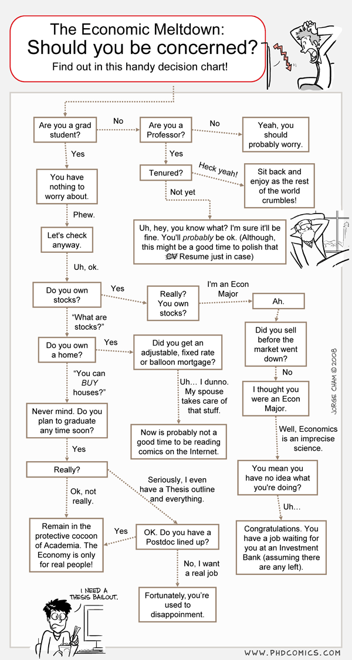
If clauses
Often we want only want to execute a bit of code when some condition is true
We can use an ‘if’ clause
if condition
%Code only runs if condition is true
…
end
if condition:
#Code if condition is true

Slide 16
If/Else clauses
Often, we also want to specify some alternative commands to run if condition is false
We match the ‘if’ with an ‘else’
if condition
%This code runs if condition is true
…
else
%This code runs if condition is false
…
end
See ‘if_else_example.m’
if condition:
#Code if condition is true
else:
#Code if condition is false

Slide 17
Elseif…
Sometimes we want to sequentially test different conditions
if condition1
%This code runs if condition1 is true
…
elseif condition2
%This code runs if condition1 is false AND condition2 is true
…
else
%This code runs if condition1 AND condition2 are false
…
end
This is just a shortcut, for nesting loops…
… see example in ‘if_else_example.m’
if condition1:
#Code…
elif condition2:
#Code…
else:
#Code…

Slide 18
Exercises – while loops and if/else
Now write a new function, that specifies a maximum number of rolls as input. If the players scores a 6 they win as before. However, if after the n-th roll they still haven’t rolled a 6, then they lose
The final display of your output should either be
Congratulations, you won after 2 rolls!!
Or
I'm sorry, you used up 5 rolls without scoring a 6. You lose!!
Hint you will need to use if/else statements
When you have finished, download all the rolling dice functions, these provide my sample answers and will be useful for you to keep

Slide 19
Summary
For loops, while loops, and if/else statements give you all the flexibility you need to write any program
Each keyword (‘for’, ‘while’, etc.) must be matched with an ‘end’
‘end’s are matched to the first keyword above it
The code between to keyword and its matching end is often called a “control block”
Indenting your code will make it much easier for you to keep track of which control block any line of code belongs to
Python doesn’t use ‘end’ (or any other symbol) to end control blocks
Blocks start with a key word (‘for’, ‘while’, etc.) followed by “:”
Control blocks must be tabbed to the same indentation
So you have to indent your code properly!

Slide 20
Summary
The function ‘loopy_min’ combines the ideas we’ve explored so far…
Note how ‘loopy_min’ is redundant because of Matlab/numpy’s min function?
Also, remember the element-wise operations on arrays?
Good Matlab and python programming means we often don’t need loops!

Slide 21
Other controls
We’ll finish this lesson by looking at a couple of other control statements
These aren’t really necessary in that you can always code their equivalent using for, while, if etc.
But you may find them in other people’s code
And they can provide shortcuts or improve the readability of code

Slide 22
Switch statements
Consider a whole bunch of if/else statements of the form
if var = val1
…
elseif var = val2
…
elseif var = val3
…
elseif var = valn
…
else
…
end

Slide 23
Switch statements (cont)
We can rewrite using a switch statement
switch var
case val1
…
case val2
…
case val3
…
case valn
…
otherwise
…
end
…no switch statements in python!

Slide 24
Switch statements (cont)
‘case’ and ‘otherwise’ are also keywords
The statement behaves exactly the same as the if/else code in the previous slide
The ‘otherwise’ takes the place of the final ‘else’ and is applied if ‘var’ does not match any of the specified values
Like the ‘else’ it is optional
Switches are particularly useful when matching strings, as it saves having to use strcmp in each if condition
See ‘if_else_example’

Slide 25
Continue, break, return
Finally, there are three more keywords that allow you to move between control blocks (same in Matlab and python)
continue
When called in a loop’s control block, skips any remaining commands in the control block and continues to the next iteration of the loop
Usually used with an ‘if’ clause to avoid processing ‘bad’ data
How else could we write this?
break
When called in a loop’s control block, skips any remaining commands in the control block and terminates the loop
return
When called in a function, immediately terminates the function
If the function has outputs, these must have been set before the return is called
In python, outputs from the function are listed after return

Slide 26
Exercises 1 – loading .mat files
Download the zip file ‘retinograms.zip’ into your data folder and extract the contents. This should generate an images folder with 20 ‘.mat’ files
Write a script to load in and display each image in a new figure – use imshow
Modify the script to convert each image to a grayscale image (hint: use ‘rgb2gray’ – see skimage.color in python) and save the new image in ‘png’ format

